Slide 1
Measuring what matters: Enhancing the use and interpretation of patient-reported outcomes in healthcare delivery
1
Jae-Yung Kwon, RN PHD
July 3rd, 2020
Notes:
I am very excited to talk about patient-reported outcomes. In my research, I combine both advanced statistical methods with nursing knowledge, and ultimately argue that the use of patient-reported outcomes can help transform healthcare on what matters to patients.
Jae-Yung Kwon is a registered nurse and currently a research associate and affiliate at Trinity Western University and the Centre for Health Evaluation and Outcome Sciences at Providence Health Care. He recently graduated with his PhD in the School of Nursing from the University of British Columbia. He also holds a specialized certification in Measurement, Evaluation, and Research Methodology in the Faculty of Education at UBC. His research interest focuses on methods in health outcomes, particularly on patient-reported outcomes and use of registry-based patient-reported outcomes in clinical practice.

Slide 2
2
Outline
About me
Research program
Case example
Research philosophy
Knowledge translation
Research plan
Teaching interest
Upcoming publications & presentations

Slide 3
Why did I choose nursing?
3
Hospital
Volunteer, South Korea
School of Nursing, UBC
Nursing practice/research
Notes:
The reason I chose nursing can be traced
Male Korean nurse

Slide 4
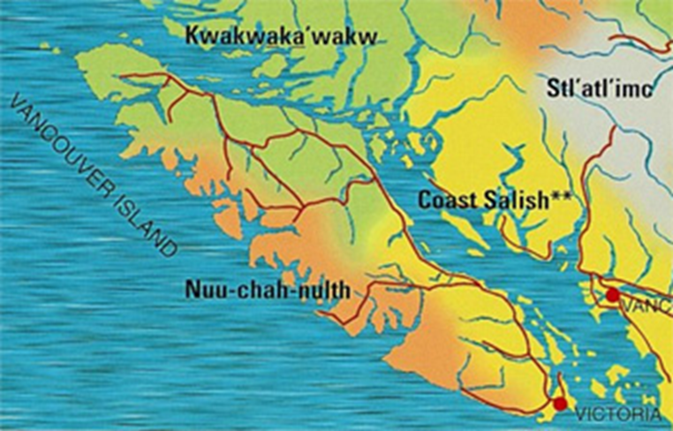
4
Lekwungen peoples
Notes:
Given my background as an Asian male nurse, I am acutely aware of the status of minorities and it seems appropriate to acknowledge the Lekwungen people and their unique relationship UVIC has to them.
you are acutely attuned to the status of minorities given your background (male Korean nurse), and it seems appropriate therefore after highlighting your minority status to acknowledge the Lekwungen people and the unique relationship UVIC has to them

Slide 5
5
Education
MSN, UBC (2014)
Thesis title: Heterosexual gender relations and fatherhood: perceptions of new fathers who smoke
PhD in Nursing, UBC (2020)
Measurement, Evaluation, and Research Methodology (certification), Faculty of Education
Dissertation title: The utility of atrial fibrillation clinical registry data in the modelling of change in patient-reported outcomes
Notes:
So to help better understand what I had experienced, I went to graduate school.

Slide 6
6
Employment
Practicing RN (2012–2015)
Vancouver General Hospital, Neuroscience Unit
Royal Columbian Hospital, Acute Care for the Elderly Unit
Instructor (2016)
Langara College, School of Nursing
Data Analyst (2016–2017)
Cardiac Services BC
Research Associate & Affiliate (2018–Present)
Trinity Western University
Centre for Health Evaluation & Outcome Sciences

Slide 7
7
Service
Program Development Committee (2009–2010)
UBC International Peer Program
Interprofessional Advisory Group (2010–2012)
UBC College of Health Disciplines
Founding Editor-in-Chief (2012–2017)
Health Professional Student Journal
Scholarship of Teaching and Research Committee (2015–2016)
UBC, School of Nursing
Journal Reviewer (2015–present)
Quality of Life Research, Nursing Inquiry, American Journal of Men’s Health

Slide 8
Motivation for research program
8
Patient-reported outcomes have great potential to better respond to patient needs
However, there is gap in knowledge about how to analyze these data in complex real-world of clinical registries
Without understanding processes for analyzing these data, insights gleaned from them will not be fully utilized to support patient-centred care
Notes:
Monitor patient progress over time and increase communication between patient and clinicians.

Slide 9
Patient-reported outcomes (PROs)
9
Symptoms
Health & Quality of Life (AFEQT)
Daily Activities
Treatment Concerns

Slide 10
My research program
10
Advanced
statistical methods
Nursing Methodologist
Nursing knowledge
Notes:
I would consider myself to be a nursing methodologist, which means that I combine advanced analytical methods with unique nursing knowledge to align methods of analysis to what actually occurs in practice. Right now, massive patient data are being collected that is largely untapped and those that are being analyzed are contracted out to statisticians who know very little about the clinical context and the workflow processes of the healthcare system. This is very problematic because it could result in wrong interpretations of the data that could negatively impact patient care.

Slide 11
Case example
11
The Utility of Atrial Fibrillation Clinical Registry Data in the Modelling of Change in Patient-Reported Outcomes
Co-supervisors: Jennifer Baumbusch & Rick Sawatzky
Committee Members: Sandra Lauck & Pam Ratner

Slide 12
Linked registry data
12
Consolidation file
Vital Statistics
Discharge Abstracts Database
PharmaNet
Medical Services Plan

Slide 13
Conceptual framework
13
Individual & Environmental Characteristics
Age, gender, distance to clinics
Treatment
Ablation
Medication
Biological Function
Patient-reported outcome
AFEQT questionnaire
Adapted from: Wilson & Cleary (1995); Spertus et al. (2002)

Slide 14
Patient journey through AF clinic
14
Referral
Re-referral
NP
RN
Cardiologist
Pharmacist
D/C

Slide 15
Growth mixture model
15
Latent class
Intercept
Slope
AFEQT T0
AFEQT T1
AFEQT T2
Notes:
Patient-centred approach that addresses equity, diversity, and inclusion issue through what’s called latent classes b/c it categorizes patients into similar patterns of scores. I will show you what this means in the next slide.

Slide 16
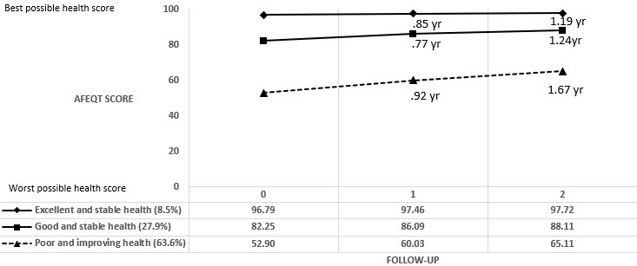
Result: three-class trajectory model
16

Slide 17
Model evaluation
17
Nagelkerke R² = 7.6%
 | Sensitivity | Specificity | PPV | NPV
Excellent and stable | 0% | 100.0% | N/A | 83.9%
Good and stable | 4.7% | 96.3% | 37.9% | 67.3%
Poor and improving | 97.4% | 3.4% | 59.9% | 46.8%
Notes:
Evaluation showed there is a lot of room for improvement

Slide 18
Action steps for nurses
18
1
2
3
Statistical method
Data preprocessing (e.g., numbers, text, images)
Feedback loop
Kwon, J.-Y., Karim, M. E., Topaz, M., & Currie, L. M. (2019). Nurses “Seeing Forest for the Trees” in the Age of Machine Learning: Using Nursing Knowledge to Improve Relevance and Performance. Computers, Informatics, Nursing: CIN, 37(4), 203–212.
Notes:
International Classification of Nursing Practice (ICNP)

Slide 19
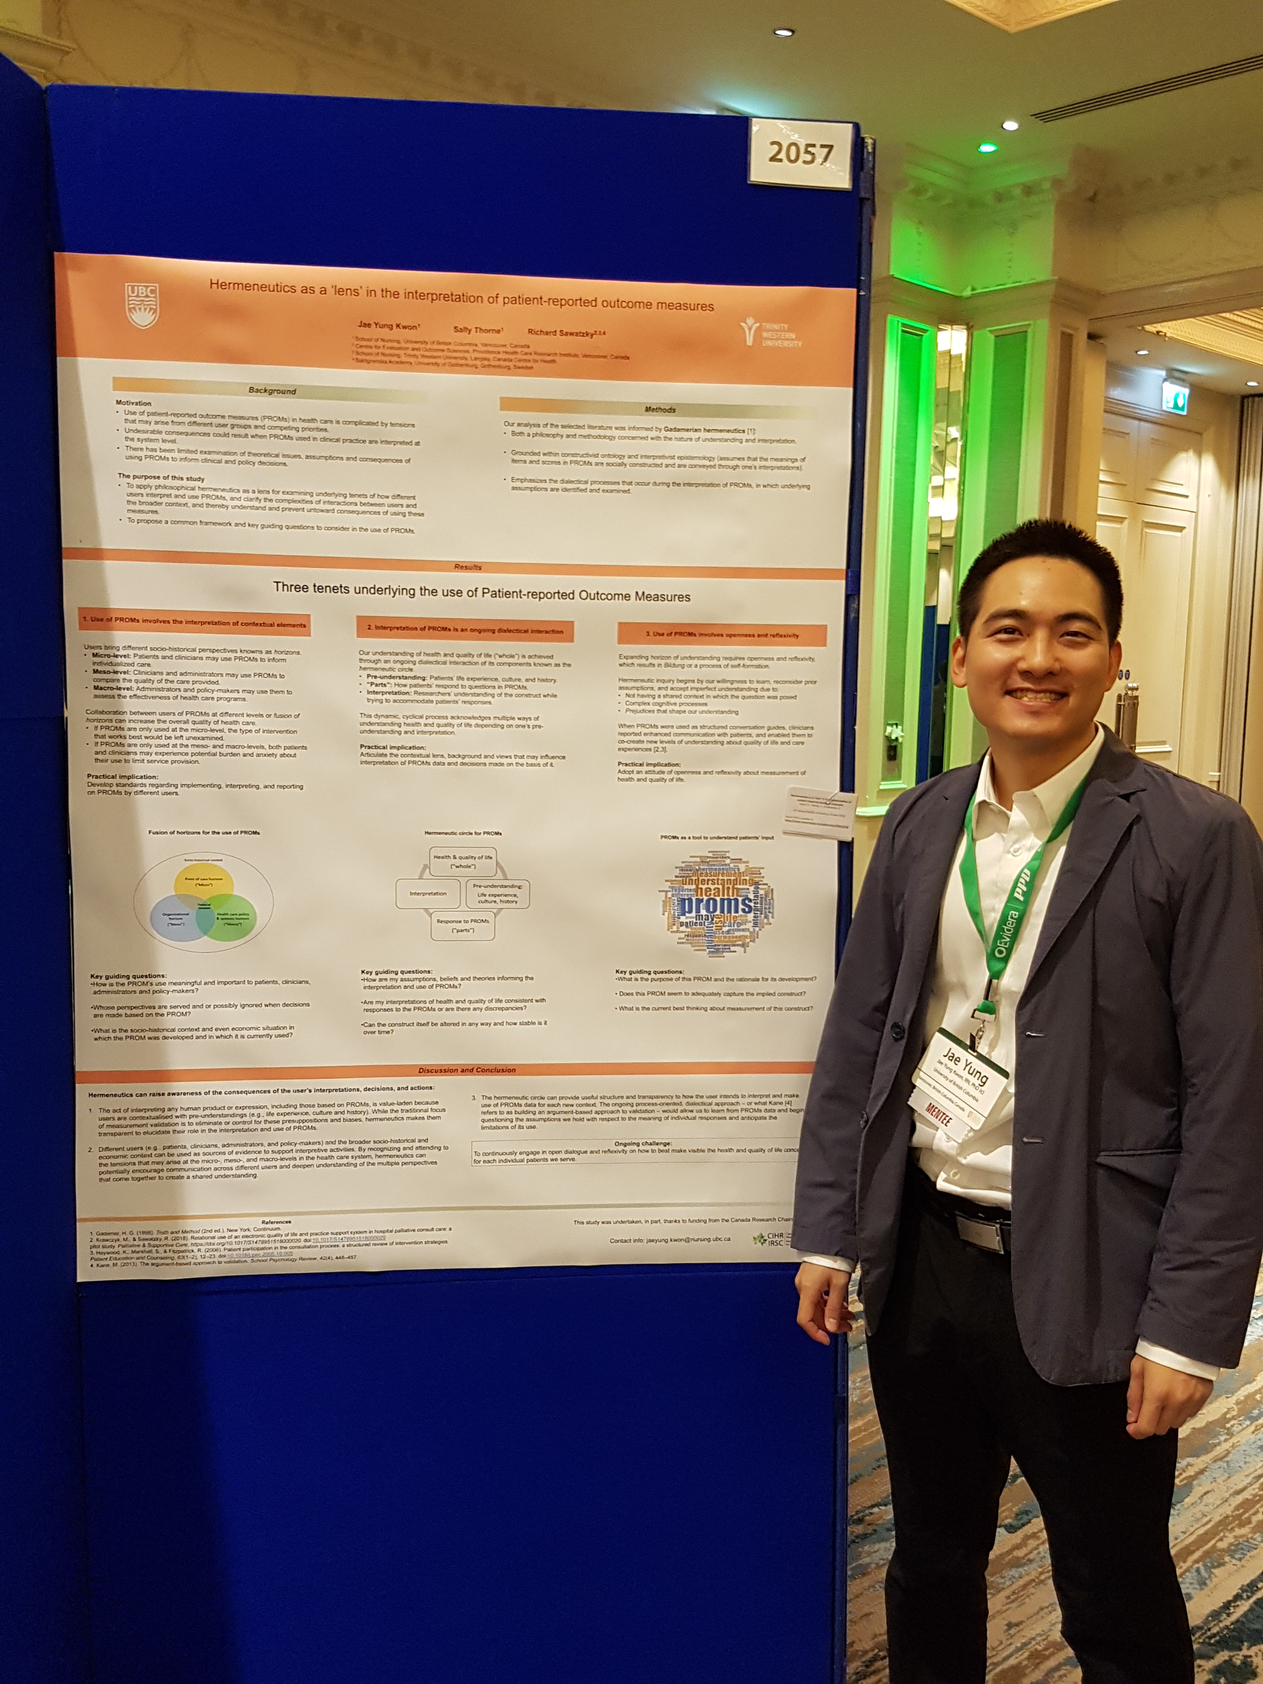
Research Philosophy
19
Use hermeneutics as a ‘lens’ to examine:
how different users (patients, clinicians, and administrators) interpret and use PROs
complexities of interactions between users and broader context
Kwon, J.-Y., Thorne, S., & Sawatzky, R. (2018). Interpretation and use of patient-reported outcome measures through a philosophical lens. Quality of Life Research.
Notes:
B/c of some of the negative consequences that could result if these steps are not followed, I used hermeneutics as a lens to better examine:

Slide 20
Hermeneutic circle
20
Health & Quality of Life (“whole”)
Pre-understanding
Response to PROs (“parts”)
Interpretation
Notes:
I specifically drew upon Gadamerian hermeneutics b/c it draws attention to this dialectical process known as hermeneutic circle.

Slide 21
“Fusion of horizons”
21
Socio-historical context
Fusion of horizons
Point of care (micro)
Health care policy and systems (macro)
Organizational (meso)

Slide 22
Three tenets underlying use of PROs
22
1. Contextual elements
2. Dialectical processes
3. Openness and reflexivity
What is the purpose of using PROs (is it specific to an intervention or program evaluation?)
How are my assumptions influencing the interpretation and use of PROs?
What is the current best thinking about measurement of this construct?

Slide 23
Response shift in sync working group
23
Mirjam Sprangers, Netherlands
Sandra Nolte, Germany
Lene Nielsen, Denmark
Wilbert van den Hout, Netherlands
Lori Frank, USA
Ruth Barclay, Canada
Rick Sawatzky, Canada
Sawatzky, R., Kwon, J.-Y…. (Accepted). Implications of response shift for micro, meso, and macro healthcare decision-making using results of patient-reported outcome measures. Quality of Life Research.

Slide 24
Knowledge translation
24
No one size fits all for measuring what matters: Supporting the use of PRO data in healthcare (Sawatzky & Kwon; MSFHR REACH Award, 2019-2020)
Project Team: Research User
Project Team: Researchers
Core Team
Rick Sawatzky (PI)
Jae-Yung Kwon (co-PI)
Ronak Brahmbhatt (coordinator)
Lena Cuthbertson, BC Ministry of Health
Sandra Lauck, St. Paul’s Hospital
Angela Tecson, Fraser Health
Lisa Lix, University of Manitoba
Tolu Sajobi, University of Calgary
Kathryn Sibley, University of Manitoba
Lara Russell, CHEOS
Collaboration with Clinical Practice Special Interest Group at the International Society of Quality of Life (ISOQOL)

Slide 25
Description of project
25
Aim
To facilitate wider uptake of knowledge in interpreting PROs for clinical practice and healthcare decision-making
Target audience
Clinicians
Clinician leaders
Clinician researchers
Decision support analysts

Slide 26
Educational resources
26
Using case studies that illustrate how to interpret and act on PROs in practice
ISOQOL Webinar
Interactive Online Learning Module
In-depth understanding among decision-support analysts to address methodological challenges in the use of PROs
TCPS2 eLearning (Adobe Captivate)

Slide 27
Future research plan at UVIC
27
“Enhancing the use and interpretation of patient-reported outcomes”
Aims
1: Use of advanced statistical methods to address diversity of patient voices
2: Integration of PROs into clinical registries to support patient-centred care
3: Knowledge translation to interpret PROs for clinical decision-making
Benefits to UVIC
MSFHR/CIHR analytics program/HSI fellowship
Expand informatics double degree program and partnerships
Strengthen UVIC’s nursing strategy 4.5 to embed nursing leadership in health systems

Slide 28
Teaching interest at UVIC
28
Undergraduate program
NURS 360: Nursing Research
NURS 425: Qualitative and Quantitative Analysis
Graduate program
NURS 604A/B: Research Methods for Nursing & Health Care
NURS 524 Evidence for Advanced Practice Nursing
NURS 525 Disciplinary Research for Advanced Practice Nursing
Health Informatics (Double Degree)
HINF 572 Health Informatics: An Overview
HINF 503 Research Methods in Health Informatics
Notes:
I am also interested in some of following courses based on my research program.
My research also influences some of my teaching interest as well.
Health informatics – teaching nursing perspective in meaningful analysis of clinical registries that includes PROs

Slide 29
Teaching background
29
Teaching/TA experience
Research for Evidence-based Practice
Critical Inquiry and Research in Nursing Practice
Statistical Literacy in Nursing
“Participation in class is awesome and I think that is in part due to the instructor’s inclusion of students’ feedback and how we are constantly applying theory to practice in class with mini-activities.”
“He has an uplifting attitude that provides a positive aura in the class that makes learning more fun.”
“Jae Yung gives us case studies, online polls, and even allowing us to participate in a mini-experiment. I feel that a lot more learning styles have been incorporated and that’s really beneficial for students.”
“This instructor is one of the most prepared teachers I have ever experienced.”
Notes:
I have previous teaching experience focusing on research and methods so I will have very little transition period. I provide you with some feedback from my students to give you a sense of what it would be like.

Slide 30
Potential course at UVIC
30
“Patient-reported outcome questionnaire development”
Textbook
Fayers, P. M. & Machin, D. (2015). Quality of Life: The assessment, analysis and reporting of patient-reported outcomes. (3rd ed.), Oxford, UK; John Wiley & Sons.
Topic
1: Principles of questionnaire development
2: Writing questionnaire and response formats
3: Psychometric properties (validity, reliability and item analyses)
Assignment
Develop a questionnaire that assess health & quality of life in clinical setting

Slide 31
Upcoming publications
31
Kwon, J.-Y., Sawatzky, R., Baumbusch, J., Lauck, S., Ratner, R. Distinct subgroups of outpatients with atrial fibrillation based on patient-reported outcome measure: A retrospective cohort study of linked registry data. Circulation: Cardiovascular Quality and Outcomes (Impact factor 4.4).
Kwon, J.-Y., Sawatzky, R., Baumbusch, J., Lauck, S., Ratner, R. Methodological considerations related to longitudinal analyses of patient-reported outcomes captured by clinical registries: A case example. BMC Medical Research Methodology (Impact factor 2.5).
Kwon, J.-Y., Sawatzky, R., Baumbusch, J., Lauck, S., Ratner, R. Challenges and opportunities of using clinical registry data to advance nursing science. Journal of Nursing Scholarship (Impact factor 2.5).
Sawatazky, R., Schick-Makaroff, K., Sasaki, A., Kwon, J.-Y… Patient- and family-reported outcome and experience measures across transitions of care for frail older adults living at home. Value in Health (Impact factor 5.0).
Sawatzky, R., Kwon, J.-Y., and the Response Shift in Sync Working Group (Accepted). Implications of response shift for micro-, meso-, and macro healthcare decision making using patient-reported outcomes. Quality of Life Research (Impact factor 2.4).

Slide 32
Upcoming conference presentations
32
Kwon, J.-Y., Sawatzky, R., Baumbusch, J., Lauck, S., Ratner, P.A. (Accepted). Health status trajectories among outpatients with atrial fibrillation. Annual Conference of the International Society for Quality of Life Research. (One of 2020 Student Poster Presentation Award Finalists)
Kwon, J.-Y., Sawatzky, R., Baumbusch, J., Lauck, S., Ratner, P.A. (Accepted). Practical guidance for the meaningful analysis of patient-reported data stored in clinical registries. Annual Conference of the International Society for Quality of Life Research. (brief oral presentation)
Shick-Makaroff, K., Silbernagel, P., Klarenback, S., Lee, L., Kwon, J.-Y.,Sawatzky, R (Accepted). PRO workshops for multidisciplinary clinicians in home dialysis. Annual Conference of the International Society for Quality of Life Research.
Sawatzky, R., Kwon, J.-Y., and the Response Shift in Sync Working Group (Accepted). Implications of response shift for micro, meso, and macro healthcare decision making using patient-reported outcomes. Annual Conference of the International Society for Quality of Life Research.

Slide 33
Summary
33
Research program
PROs can provide unique insights that can help transform healthcare on what matters most to patients
It provides more visibility to nursing work and better individualizes patient care
Teaching
Equip nurses with competencies for the meaningful analysis and use of PROs
Position nursing graduates in leadership roles for health system change

Slide 34
Thank You! Questions?
34

